Slide 1
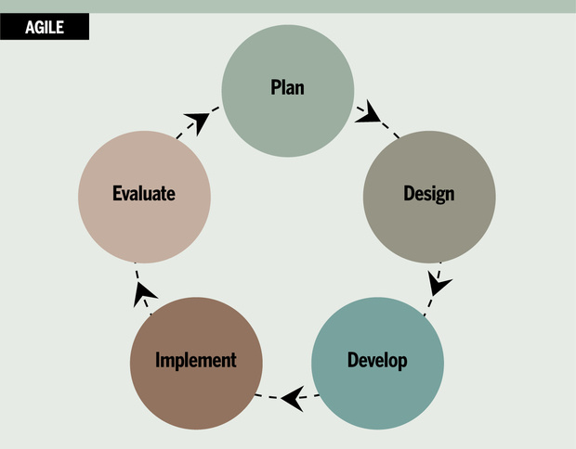
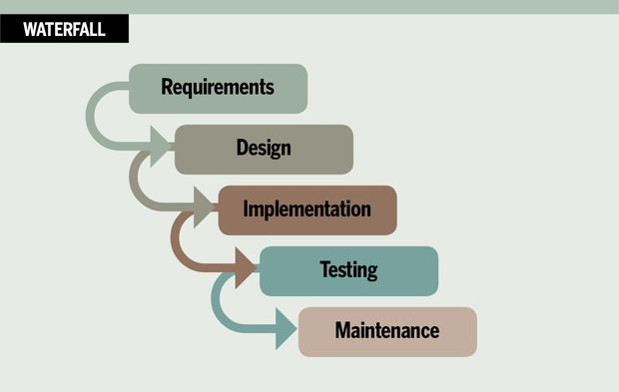

Development Management
Agile VS Traditional methodologies for game development
Notes:
Hello my name is Lewis, In this video I will evaluate project management methodologies, and advice and recommendation of the most optimal methodology for game development.

Slide 2
Iterative Development
Notes:
Pros and cons of both
Time reaonl

Slide 3
Traditional Development
Notes:
Pros and cons of both

Slide 4
Scrum
Notes:
Scrum is an iterative development process that incorporates close cooperation between employees. A key

Slide 5
eXtreme Programming (XP)
Notes:
it

Slide 6
User Testing
Notes:
it

Slide 7
Tools
Notes:
it

Slide 8
Recommended Method
Notes:
it

